Slide 1
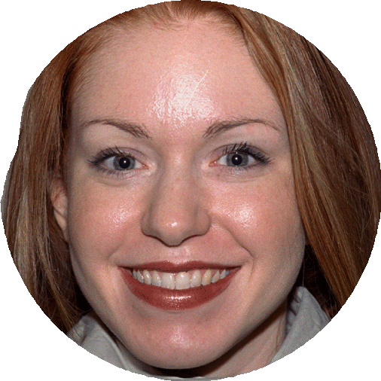
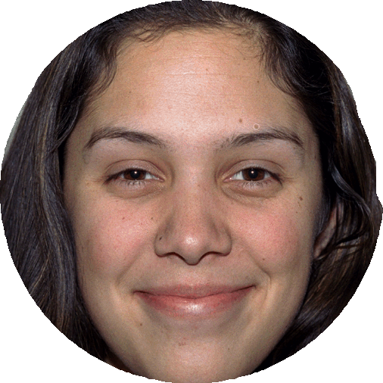
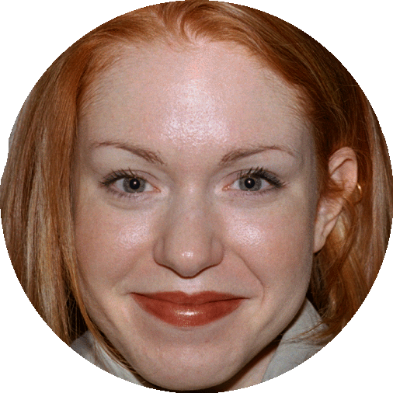
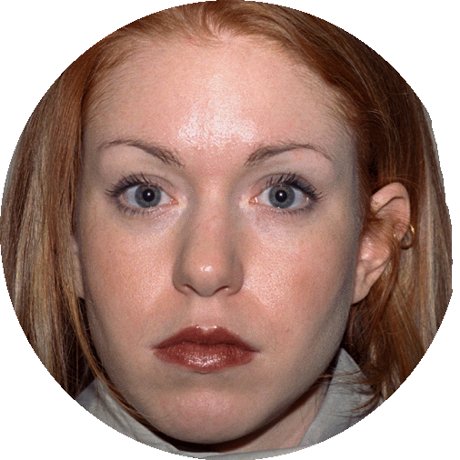
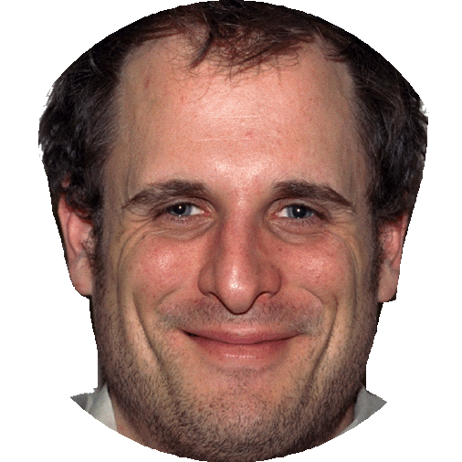
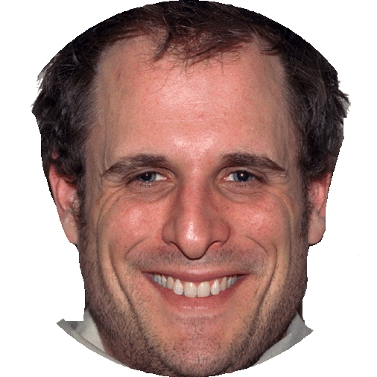
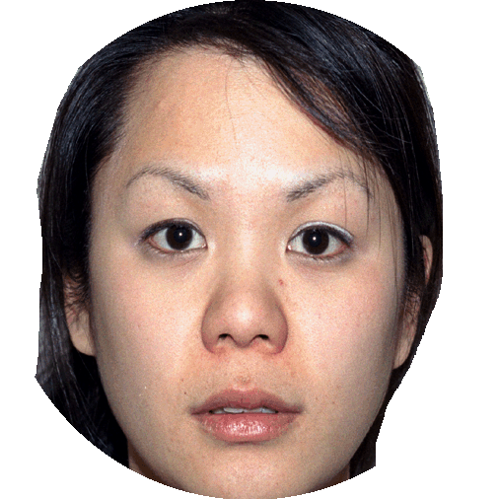
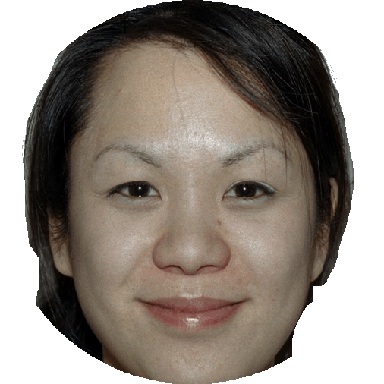
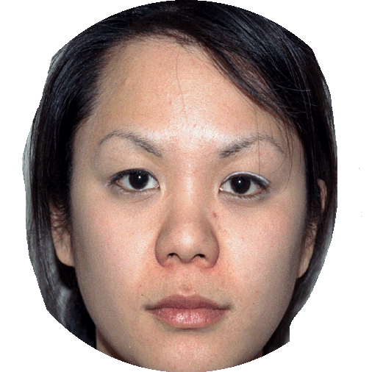
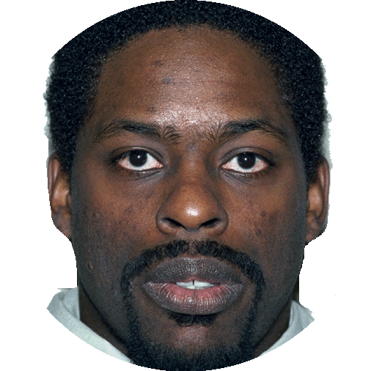
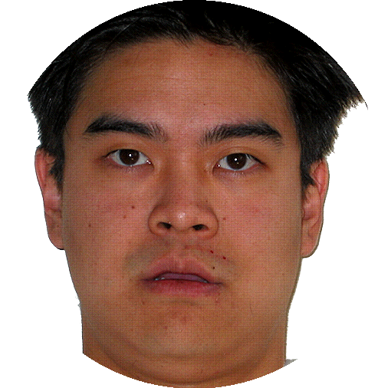
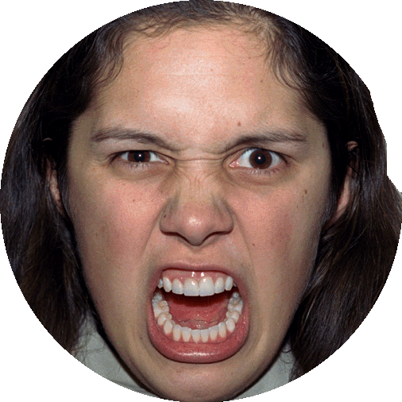
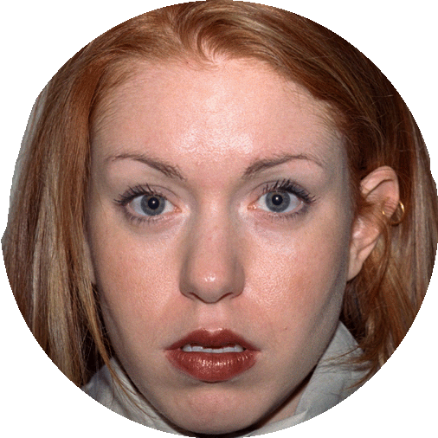
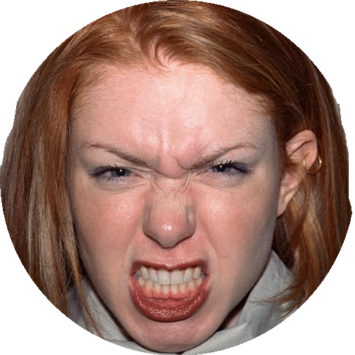
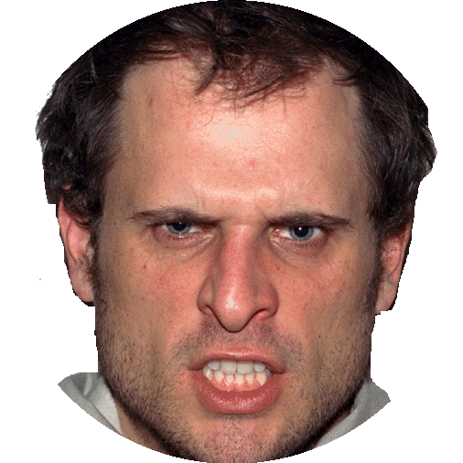
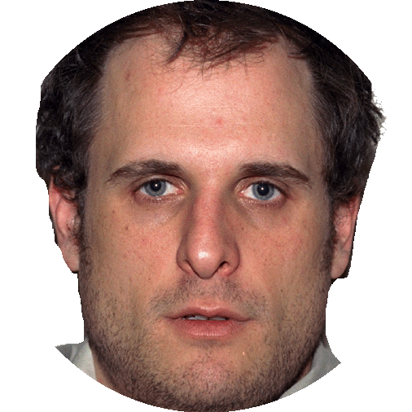
Fixation cross
Cue
Faces
Response
1000ms
500ms
750ms
max.5000ms
Easy trials: 1 to 7
e.g. 1 happy faces & 7 neutral faces.
Even trials: 4
e.g. 4 happy faces & 4 neutral faces.
Hard trials: 3 to 5
e.g. 3 happy faces & 5 neutral faces.
G
.
N
+
+
N
.
B
+
+

Slide 2
Fixation cross
Cue
Faces
Response
1000ms
500ms
750ms
max.5000ms
G
.
N
+
+
Easy trials: 1 to 7
e.g. 1 angry face & 7 neutral faces
Hard trials: 3 to 5
e.g. 3 angry faces & 5 happy faces.
B
.
N
+
+
B
.
G
+
+

Slide 3
Affective value (+/-)
T
Shift in drift rate DDM
affective
+
Mean representation of object identities
neutral
R
Response selection
+

Slide 4
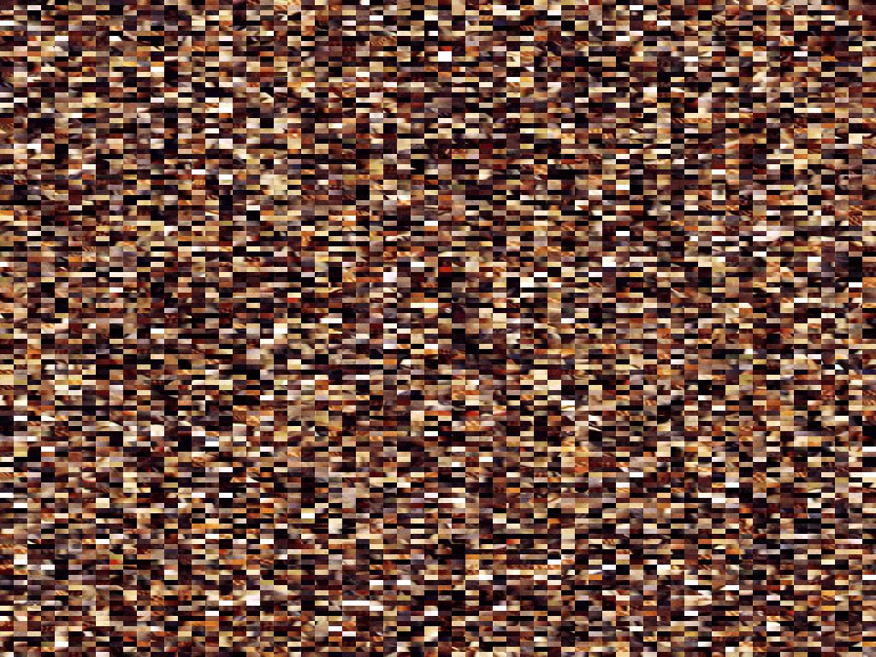
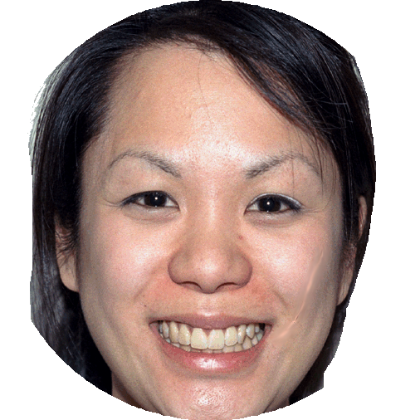
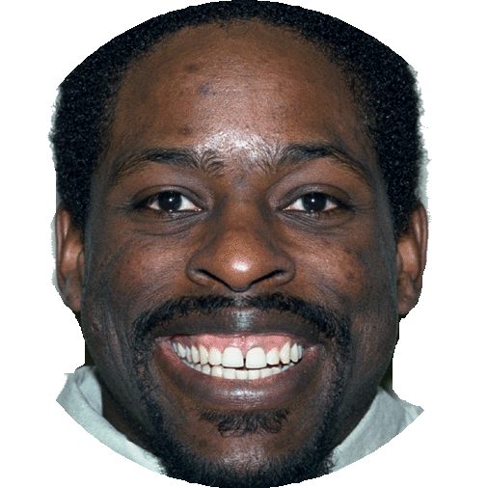
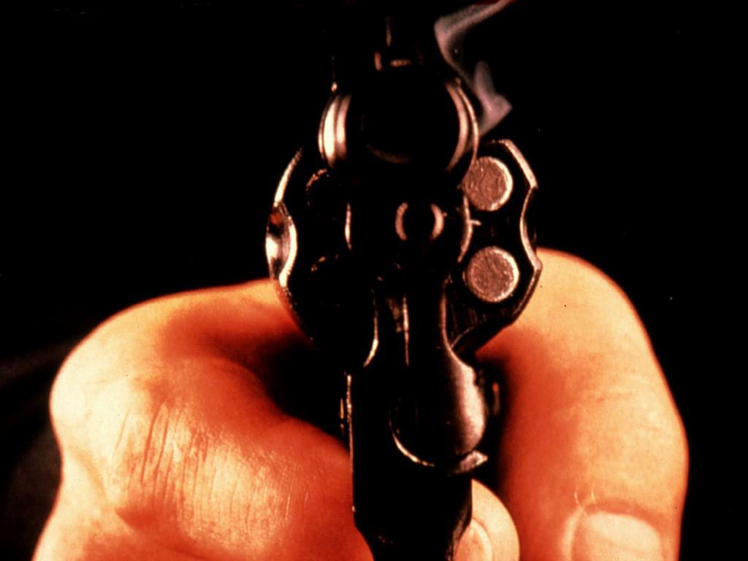
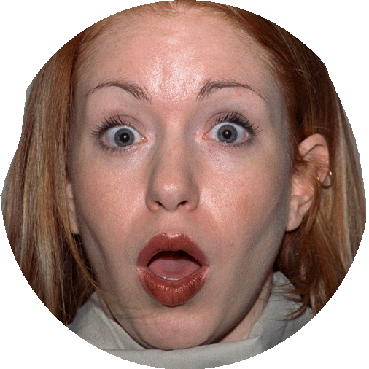
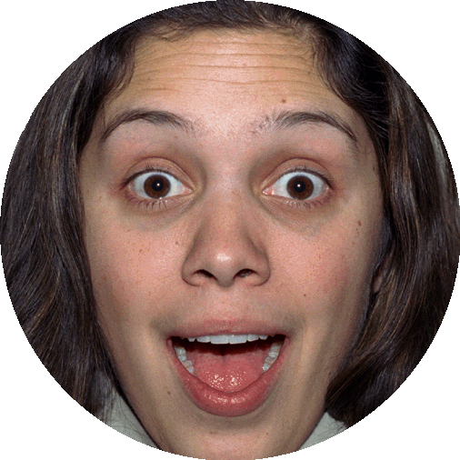
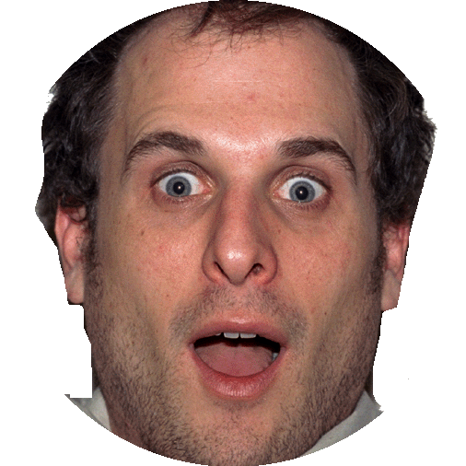
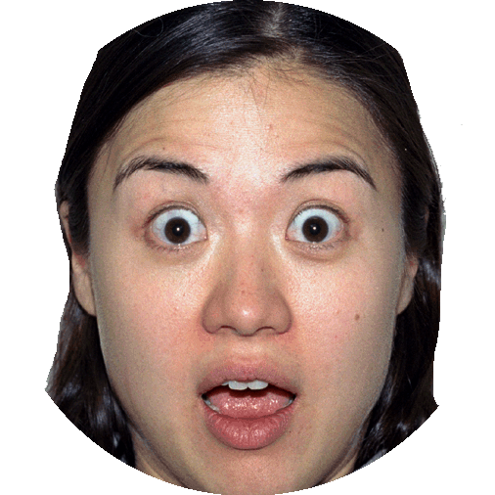
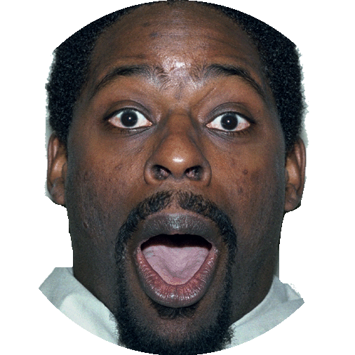
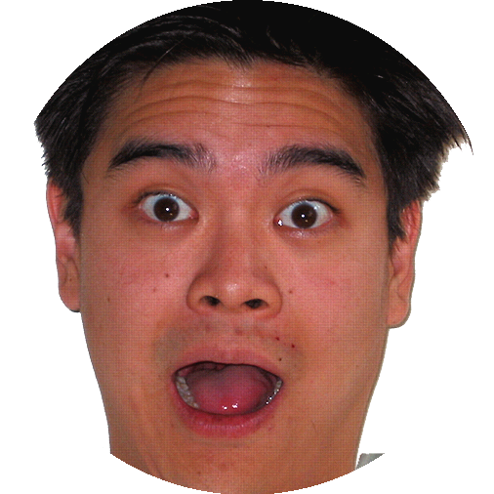
(2) max.5000ms
Fixation cross
Cue
Priming
Faces
Response
1000ms
500ms
400ms
750ms
(1) max.5000ms
Fillers
(20%)
-
.
+
+
+
1/3 positive prime
1/3 negative prime
1/3 scrambled prime
B. Target
(80%)
-
.
+
+
+

Slide 5
T-1
Affective value (-)
T
Affective value (?)
+
Shift in starting-point bias DDM
-
R
Response selection
+
+

